Slide 1
School Network
-Deep Shah(10557732)

Slide 2
Proof Of Concept for the Network Deployed
School Network built for the project
Servers Used for the project
Advantages of this network

Slide 3
Proof Of Concept for the Network Deployed
Building a Smart School.
Monitor students daily activities and progress through reliable communication and connection of school departments for administration and management tasks.
Handling of resources in an efficient manner.

Slide 4
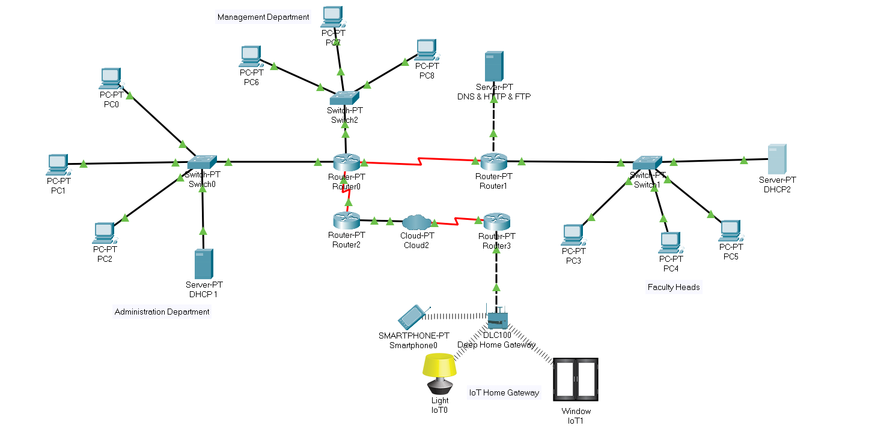
School Network built for this project

Slide 5
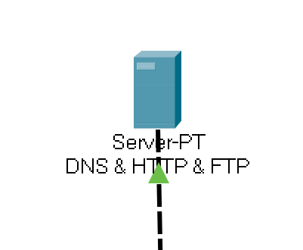
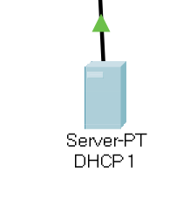
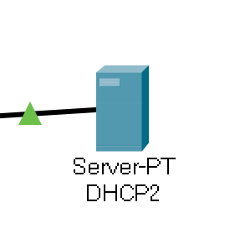
Servers Used for the project
DHCP FTP
HTTP DNS

Slide 6
Advantages of this network
P 2 P connections (peer to peer).
IOT Connection through Home Gateway.
Reliable Connections
Multiple servers to avoid high damage during any system failures.

Slide 7
DEMO

Slide 8
Thankyou

